Slide 1
“Hands-free" control of a Quadcopter
AUTHOR: NANDI GUO
ID NUMBER: 14311495
SUPERVISOR: Dr. Steve Greedy
MODERATOR: Dr. James Bonnyman

Slide 2
Contents
01. Introduction
03. Project implementation
- Introduction of the project
- Hardware design
- Aims and objectives
- Gesture recognition (Leap Motion)
- Software design
- Quadcopter
02. Project Design concepts
04. Project Conclusion
- Design concepts
- System evaluation
- Project concept analysis
- Future work

Slide 3

The quadcopter, or drone, is generally controlled by a handheld remote controller which could be a challenge for beginners or those with limited mobility, or mobility issues. Research has shown that most of the beginners do not have enough knowledge about the fly modes of a copter (Throttle, pitch, yaw, roll).
This project aims to remotely control a Quadcopter by using a system based on gesture recognition to bring a fresh and easy control concept for users.
PROJECT Introduction
A hand gesture sensor called Leap-Motion would be used as a control component, users could control the quadcopter easily by wave their hands, the height of the left hand determines the flying height, and the plane position of the right hand determines the flying direction. The signal generated by the gesture sensor would be sent to a microcontroller which is able to control the mechanical components which are fixed on the original handheld controller.

Slide 4
Aims and Objectives
Aims:
This project aims to offer a human interface based on gesture recognition instead of the traditional handheld controller.
The traditional handheld controller should be modified and combined with the gesture recognition sensor system, the gesture sensor should be able to control the quadcopter to fly.
Objectives:
Understand and become familiar with microcontroller and its General-purpose Input / Output (GPIO) pins.
Integrate gesture recognition and microcontroller into a whole system.
Develop codes to transmit the signals between the microcontroller and gesture sensor.
Evaluate and test the system’s software and hardware as a whole system.
Make the system can precisely control the throttle of the quadcopter.

Slide 5

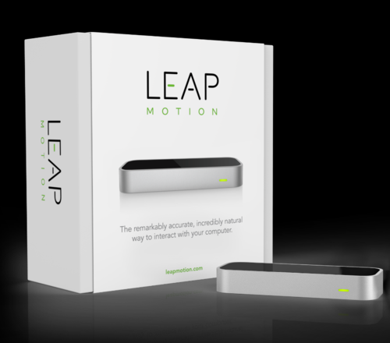
Gesture recognition (Leap Motion)
During this project, a gesture sensor called leap motion is used to control the Quadcopter.
Leap Motion is a device that detects and tracks hands. The device operates close to the user and is able to track movements with high accuracy and high tracking frame rate.
The advantages of Leap Motion are listed below;
1.Most accurate, Embedded in PCs and tablets, better suited for PC games and apps, limited capability, awkward placement.
2. Cheap.
3. Portable and easy to be connected.
4. Easy to be programmed and developed.
Microsoft’s Kinect is another gesture sensor also considered for the project but it is less portable, expensive and harder to be developed.
Therefore, the Leap motion, a hand gesture sensor, will be used as a remote controller.

Slide 6
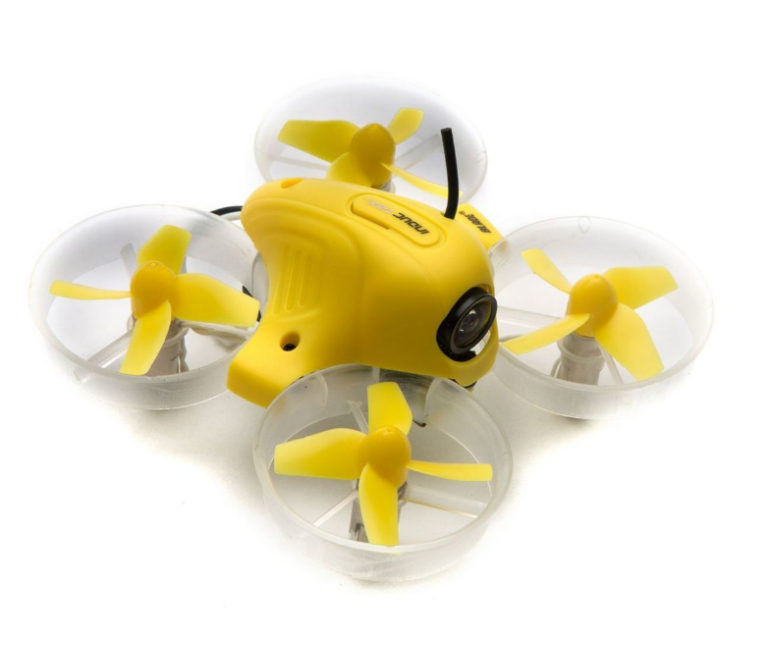
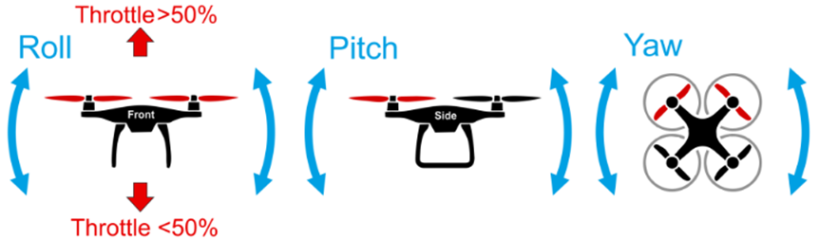
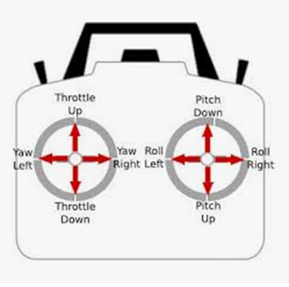
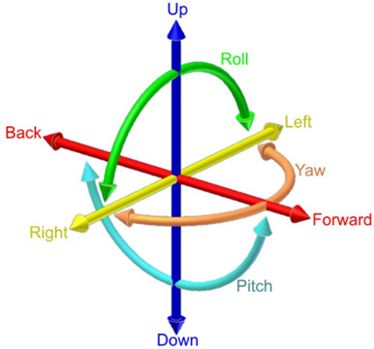
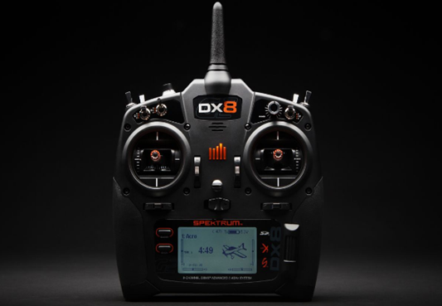
Quadcopter
Inductrix blade small copter is used in the project.
A typical quadcopter is using a 4-channel controller that sends commands in the copter to control its throttle (up & down), pitch, yaw, roll.
In general, users have to learn how to use the controller and they have to memorize all the functions before they try to fly the copter. This is a difficult process with a steep learning curve, especially for beginners. The traditional remote controller uses two joysticks that could move in four directions respectively. Normally, one stick controls the throttle and yaw whilst the other controls the pitch and roll.

Slide 7
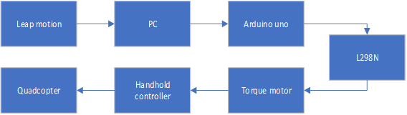
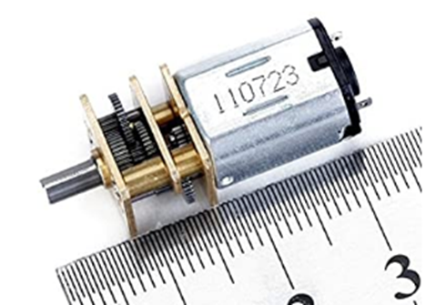
Project Design concept 1
The SG90 servo motor concept 3 was considered as a final plan
In the design concept 1, the leap motion is connected to PC first, then the signal and data from the Leap motion should be collected and programmed by using a software on PC (processing3), after that the Arduino IDE on PC would transmit the signal to Arduino board.
The L298N motor drive would be connected to Arduino, then the signal from Arduino should make the L298N be able to control the rotation of the motor, the gear of the motor should be able to pull or push the throttle joystick on the handheld controller. Thus, the hand gesture could control the Quadcopter to fly high or low.

Slide 8
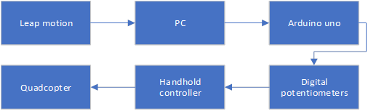
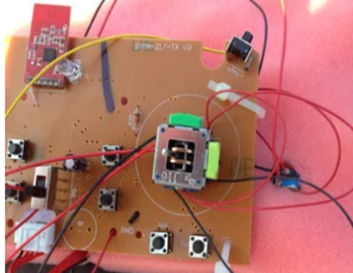
Project Design concept 2
The SG90 servo motor concept 3 was considered as a final plan
In the design concept 2, the leap motion should be connected to PC first, then the signal should be handled and transmitted by using a programming Software (processing 3) on PC, the signal then will be transmitted to Arduino board, after that the Arduino would send the signal to the digital potentiometer circuit.
The digital potentiometer circuit need to be connected to handhold controller by modifying the wires inside the DX8 controller, therefore the joysticks now are replaced by “voltage signal” from the digital potentiometer, and the “voltage signal” would be able to send the control commands to the Quadcopter.

Slide 9
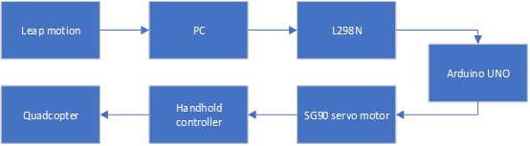
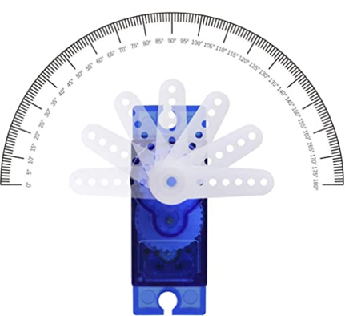
Project Design concept 3
The SG90 servo motor concept 3 was considered as a final plan
In the design concept 3, the leap motion should be connected to PC first, then the signal should be handled and transmitted by using programming Software on PC.
After that, the signal is sent to the Arduino board. The SG90 servo is connected to Arduino, therefore the codes in Arduino should be able to control the rotation of the SG90 servo motor. The gear of the SG90 servo motor should be able to pull or push the throttle joystick on the handheld controller. Thus, the hand gesture could control the Quadcopter to fly high or low.

Slide 10
Project concept analysis
The SG90 servo motor concept 3 was considered as a final plan
The advantages and disadvantages of the concept 3 are listed below.
Advantages | Disadvantages
Have enough torque to pull and push the joystick on handhold controller. The plastic shell of SG90 is easy to be fixed on the handhold controller Can be fixed on the outside of the handhold controller, no need to open up the expensive DX8 controller. High accuracy and fast response speed, the rotation degree can almost follow the height of the user’s hand. Simple circuit and concept required. Cheap and fewer components required | 1. Need at least three to achieve full functions, they would require a large space to be fixed on the handhold controller.
The concept 3 includes both advantages of concept 1 and concept 2 and only has a few disadvantages.
Thus, concept 3 would be selected as a final implementation plan.

Slide 11
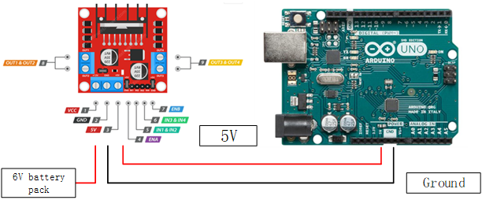
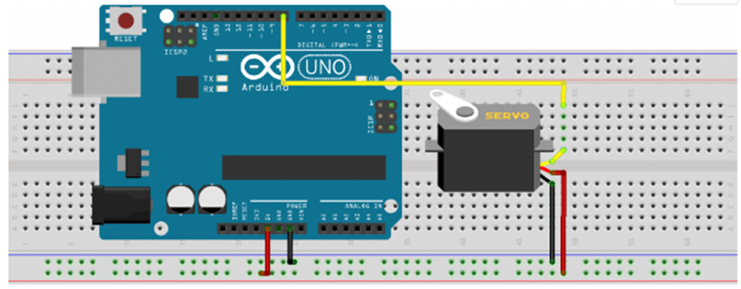
Project implementation
Hardware implementation
Voltage regulator, this could provide the Arduino board a constant 5V power supply.
This circuit is to control the rotation of SG90 servo motor.

Slide 12
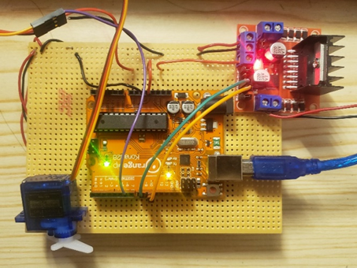
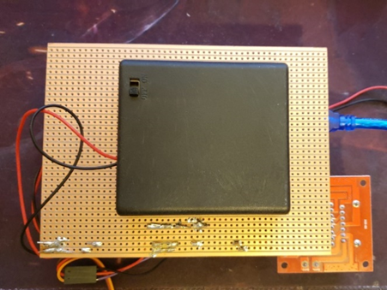
Project implementation
Hardware implementation
The whole circuit construction can be seen below

Slide 13
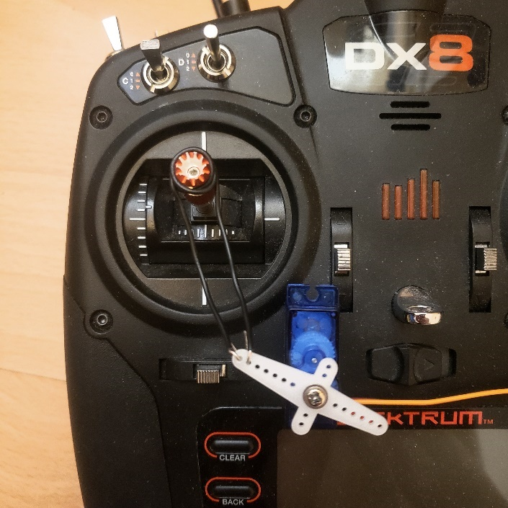
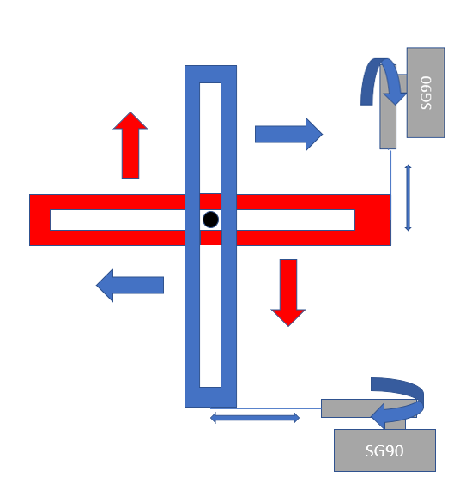
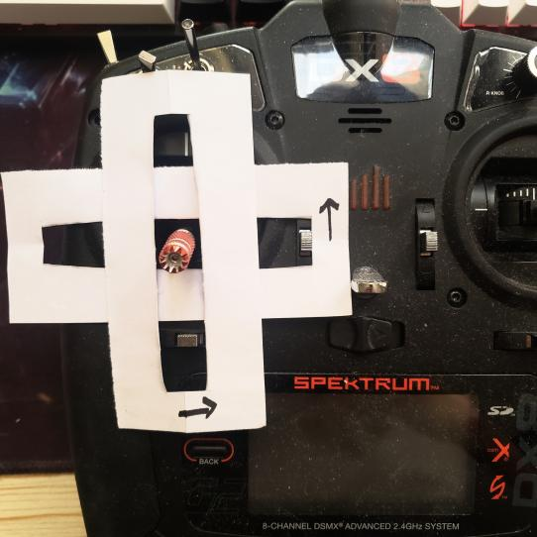
Project implementation
Hardware implementation
The position of SG90 servo motor can be seen below
Method 1: Iron wire connection
Method 2: 3D print mechanical structure
In theory, 3D print structure is the best method, it is convenient for subsequent upgrades.
Due to the COVID-19 situation, the 3D print method is hard to be achieved.
Method 1 is current using, the performance is relatively stable and the structure is simple, it is easy to be achieved. There would further development for it later.

Slide 14
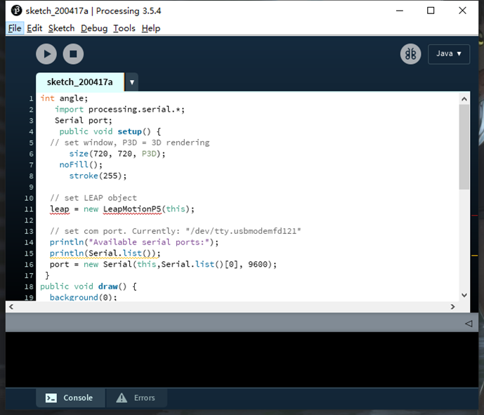
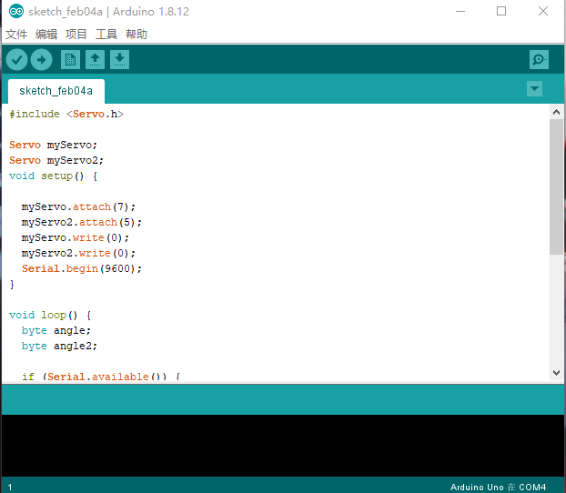
Project implementation
Software implementation
Processing 3 here is for handling the signal from leap motion on PC, then transmitted the signal to Arduino board. C programming language would be used to develop the code.
When the Arduino board receives the signal, the codes in Arduino would read the degree data of hands then make the SG90 servo motor rotate. Thus the throttle joystick can be pulled/pushed by SG90 servo motor.

Slide 15
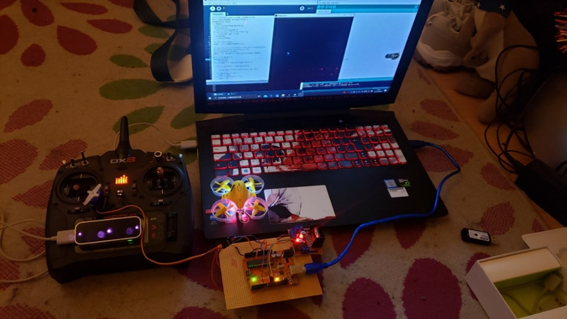
Conclusion
System evaluation
Achievements:
Battery-powered and power plug are successful.
Leap Motion recognition successful.
Signal transmission successful.
SG90 servo motor is following the fingers to rotate properly.
Throttle joystick moved properly.
Quadcopter throttle control successfully.

Slide 16
Conclusion
Future work
Overall, all the objectives and tasks are achieved successfully. The throttle of the Quadcopter can be controlled by the Leap Motion gesture sensor properly.
Future work:
It is necessary to 3D print the mechanical structure between the SG90 motor gear and the joystick of the handheld controller, the mechanical structure is convenient for subsequent upgrades.
The other Leap motion and control system board is required to achieve the direction control of the Quadcopter.
Communication codes between the Leap motion and Arduino also could be optimised and upgraded to increase the response speed of the gesture recognition.
Due to the COVID-19 situation, lots of components cannot be delivered and the work which required laboratory cannot be finished, however, all important parts of the project have been completed successfully on time.
With sufficient conditions, the further work could be achieved easily.

Slide 17
THANK YOU

